Slide 1
NavX:
Joint Preliminary/System Design Review
Team:
Alvin O’Garro
Jacob Jeong
Antony Samuel
Kartik Sastry
Notes:
Instructions:
Title page helps organize the presentation.

Slide 2
Design Review Scope
System Overview
–Concept of Operations (CONOPS)
–System Integration/Usage
–Mission Level Description
–System Block Diagram
–Interfaces
–Critical Success Factors
Requirements
–Requirements Allocation
–Performance Metrics and Analysis
Implementation Proposal
–System Trade Offs
–Software Design Analysis
–Risk Analyses
Path Forward
–Cost to Finish Implementation
–Predicted System Performance
–Schedule to Finish Implementation
–Upcoming Plans
Notes:
Reference: Best Practice.
Why: Set general expectations for this review, above those stipulated by command media or Customer. Prepare the committee for what they’re about to see.
Instructions: List any major topics not included. Any deletions that will be obvious to the reviewer need not be included here. Take Away is to remind the Review preparer what his task is, and can be removed if desired.
Special points, weaknesses, critical issue, etc. should be pointed out here before the review starts. Call the reviewer’s attention to key points. Prime the audience as to how well the team has done.

Slide 3
Concept of Operations (CONOPS)
System Purpose / Objective
Plan a ’high-level’/’global’ path for an autonomous vehicle through austere terrain
Minimize the total distance travelled
Provide waypoints (sequence of coordinates) that define the path
Account for mobility limitations of the particular autonomous vehicle
System User
Operators of the autonomous vehicle
In ECE 4012 – Design Team B
Outside of ECE 4012: Harris Corp. and/or potential clients

Slide 4
System Integration/Usage
Path Planner
LiDAR Drone
Terrain Data (LAS)
Waypoints
Navigational Robot
User
Robot Limitations
Start/End Points
“Connectivity”
Command Line Input
Wired/WLAN

Slide 5
Mission-Level Description

Slide 6
System Block Diagram
Path Planner:
Data Parsing
Point Classification Preprocessing
Graph Generation
Graph Traversal (A*)
Waypoint Generation
Terrain Data
‘K’
‘K’
Robot Limitations
Start/End Points

Slide 7
Interfaces
External Interfaces - With User
Input data must adhere to the LAS standard
Output waypoint format - list of (x, y, z) tuples
Allows flexibility for user to localize in 2D or 3D
Internal Interfaces - Data Exchange Between Software Components
Parser - Preprocessing Interface:
LAS File parsed into array of Point objects and input to classifier
Preprocessing - Graph Generation Interface:
Preprocessing maintains the representation of Points, passes to graph generation
Graph Generation - Graph Traversal Interface:
A graph
Graph Traversal - Waypoint Generation Interface:
Graph Traversal (A*) outputs a list of nodes. Waypoint Generation is a coordinate transformation.

Slide 8
Critical Success Factors
What is important to the Customer:
Schedule: Project completed by Senior Design Expo
Technical: Project successfully generates and illustrates waypoints
Sponsor Relationship: Maintaining Harris communication for project direction
Systems Engineering: Maintaining System Block Diagram
Engineering Management: Assigning a Responsible Engineer for every requirement and subsystem
Methods of Technical Evaluation
LiDAR data parser output validated with Geographic Information System (GIS) Software
Employ an existing path-planning tool to verify generated path
3D Visualization
Illustrates terrain and calculated waypoints (sanity check)
Visually verify generated path conformance with robot limitations
Notes:
Reference:
Why: Defines CSF’s.
Instruction: Body may be adapted as required.
Do we really understand what’s important to the Customer and End-User?
There are sometimes key attributes of an offering that are not specified in the RFP. Note these conflicts and discuss our approach.

Slide 9
Requirements Allocation
(Formation of sub-tasks): See System Block Diagram
Data Parsing
The project shall correctly read .las file and convert data fields to usable data
Point Classification Preprocessing
The project shall remove unnavigable points (ie. canopy, water), k-nearest-neighbors classification of unclassified points
Graph Generation
The project shall generate graph representation for points
Graph Traversal (A*)
The project shall compute shortest distance path from user-specified start/end points
Waypoint Generation
The project shall transform graph nodes into geographical coordinates
Notes:
CI – Configuration Item
CSC – Computer Software Component
CSCI – Computer Software Configuration Item
CSU – Computer Software Unit

Slide 10
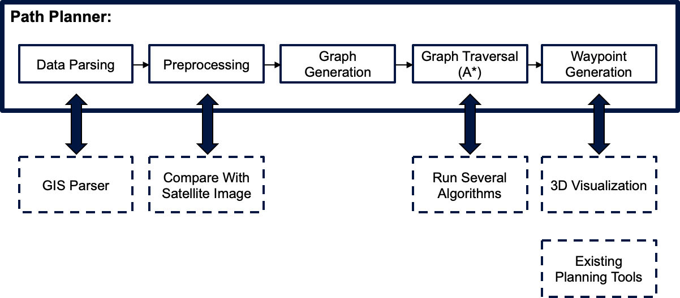
Performance Metrics and Analysis
“How good is the path?”
The project shall characterize the ‘deviation’ of our path from an ideal or reference path
“How long does it take to compute?”
Note: Important if runtime becomes critical
Subsystem validation depicted below:
Notes:
Define TPMs definitions (as required)
Define lower-level TPMs
Define and allocate lower level TPMs to CIs (as appropriate)
To support system TPMs and/or measure key internal risk items
Document the calculation method used to combine lower-level TPMs into the system TPM
Initiate TPM tracking
Disseminate results to the program team (consider display boards)
Outputs
TPM definitions (revised)
Performance predictions

Slide 11
System Trade-offs
Significant Tradeoffs
Spatial density of data vs computation resources.
Higher spatial density allows finer path control and better terrain representation, but requires a more memory intensive graph.
Path optimality vs computation time.
More accurate paths can be generated, but at the expense of computation time.

Slide 12
Software Design Analysis
Critical Timing
No timing constraint
Memory Utilization
Point storage requirements alone scale linearly with k
Bulk of memory required
Points stored as (X, Y, Z, Class): 3*sizeof(float) + sizeof(int)
Nodes stored as (Point, Point[k]): (k+1)*sizeof(Point)
On the order of MB for 100,000 points in .las file
Processor Loading
Single Core - Single Thread For Now
May parallelize graph generation in the future

Slide 13
Risk Analyses
Since the project is purely software-related, all associated risks are results of software malfunctions/miscalculations.
Risk 1: The generated waypoints guide the robot through unnavigable terrain or unseen obstacles
User maintains option to go into “manual mode”
Risk 2: Map generation takes longer than preferred
User inputs a ‘K’ values correlating to path options
Notes:
Identify major system technical risks
Concerted effort to identify problems in each technical area
Involve key Customer technical contacts
Classify (cost, schedule, and/or technical) and quantify (impact) for each risk
Estimate Probability of Risk Element Occurrence (Po)
Very High Risk 90%
High Risk 75%
Medium Risk 50%
Low Risk 25%
Very Low Risk 10%
Establish/maintain a "watch list“
Estimate cost impacts, including material, schedule, and/or labor costs (for contingency plan)
Weight Proposal costs and current estimated costs based on Po
Evaluate on a monthly basis
Create risk reduction plans and schedules
Submit to Customer for review and approval prior to implementation
Update at the end of each phase or upon identification of a new risk item
Develop contingency plans and costs in the event that the risk is realized
Statement and assessment of risk/problem
Consequence of failure
Activities undertaken to prevent risk form occurring, if possible
Steps to take if the risk occurs
Alternatives considered with risk and cost of each
Implementation impact statement (cost/schedule/technical)
Criteria for closure of the risk activity
Decision points
Recommended back-up developments and tests and their associated costs
Person responsible for the risk item
Initiate risk tracking and mitigation activities
Assign responsibility for tracking and reporting each risk area
Update SEMP
Submit risk mitigation plan to Customer for review and approval of each high-risk item
Risk Reduction Reports (RRRs) as required
Present Program Technical risks at monthly Program Reviews
Outputs
Risk mitigation plan

Slide 14
Cost to Finish Implementation
Average software engineering salary: $41.17/hour
Working hours per week: 8 hours/week
Remaining weeks: 7 weeks
Per member salary estimate: $2305.52
Total cost estimate: $9222.08
Notes:
Has an estimate of the cost and schedule to implement the system architecture been developed?
Are the costs and schedule estimates based on historical data?
Are the estimated costs and schedule adequate to implement the system architecture?
Has the program team bought into the estimated cost and schedule?

Slide 15
Predicted System Performance
Following current rate of progress, system performance will reach our goals. Specifically, our process for generating waypoints will effectively provide appropriate coordinates for the navigating robot
Performance Analysis:
Produce Output
Input LiDAR data in LAS format
Parse LiDAR data to get point coordinates/point classification information
Input point array into path-planning algorithm
Produce waypoint Array
Evaluate
Illustrate Waypoints using 3D Visualizer
Overlay Waypoints on top of terrain visualization for path verification
Compute deviation from a baseline / ideal path, if one exists
Notes:
CheckList H-2379-4:
Has a system performance analysis been performed?
Does the architecture model and the performance analyses show that the system implementation is feasible?
Has the program team bought into the system performance analysis?

Slide 16
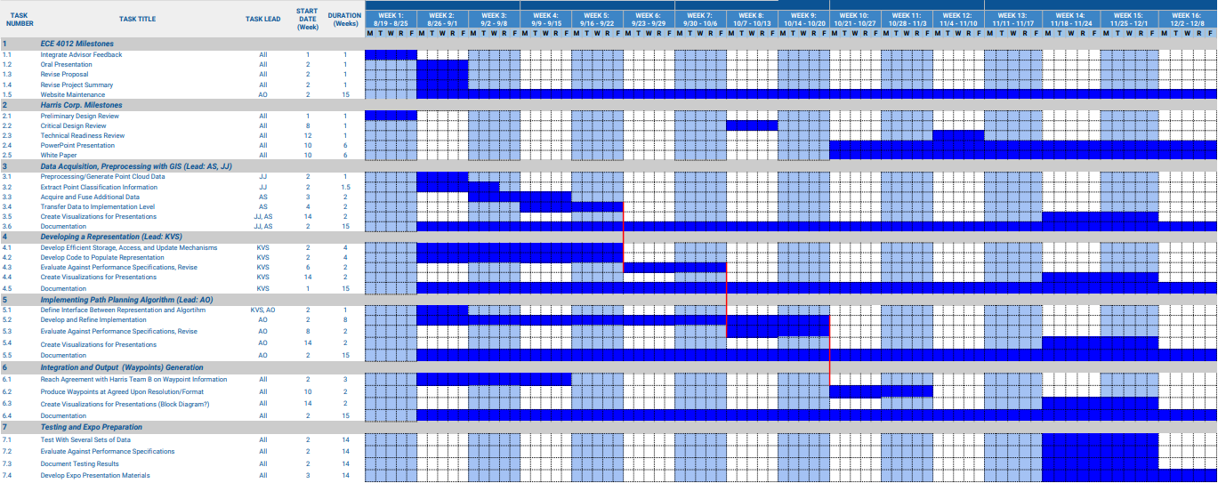
Schedule to Finish Implementation
Notes:
Has an estimate of the cost and schedule to implement the system architecture been developed?
Are the costs and schedule estimates based on historical data?
Are the estimated costs and schedule adequate to implement the system architecture?
Has the program team bought into the estimated cost and schedule?

Slide 17
Upcoming Plans
Logistical Milestones:
Technical Readiness Review
Critical Design Review
White Paper
Current State:
LiDAR Data Parser and Preprocessing (Kartik Sastry)
Terrain Analyses of LAS Data with GIS (Jacob Jeong)
Implementing Path Planning Algorithm (Alvin O’Garro) - Present
3-D Waypoint Visualization (Antony Samuel)
Capstone Design Expo – December 4th, 2018
Notes:
Each Produced Plan should have a summary brief
Point out connections/links to design
Identify and brief in greater detail any significant plans that address Program or Customer Concerns (Areas of Interest) or Risks

